Slide 1
MSc Project Presentation
John Booth
August 2019

Slide 2
Aims
To develop a routine to extract data from the existing Post-mortem Research Database into an entity attribute value schema that will make the data more readily available for data analytics.
To apply the Decision Tree Analytical method to the extracted data to develop operational strategies that can be applied to paediatric post-mortems to prioritise which data is required to achieve the target of determining the cause of death.
To investigate ensemble strategies, specifically Random Forests and Gradient Boosting to see how these techniques can improve on the basic Decision Tree method.

Slide 3
Methods
Reproducible results - Develop Project pipeline
PM Research Database => EAV Schema => Summary and Study based Attributes => RDV production => RDV Adjustments => Run models => review results
Python
Data Engineering
PyCharm IDE
Testing and Profiling
R
Analytics and visualisation
Models evolved through three stages
Individual model
Model run for all PM stages
Model as a function called with multiple random keys.
Use of GIT Hub for version control on all documents.

Slide 4
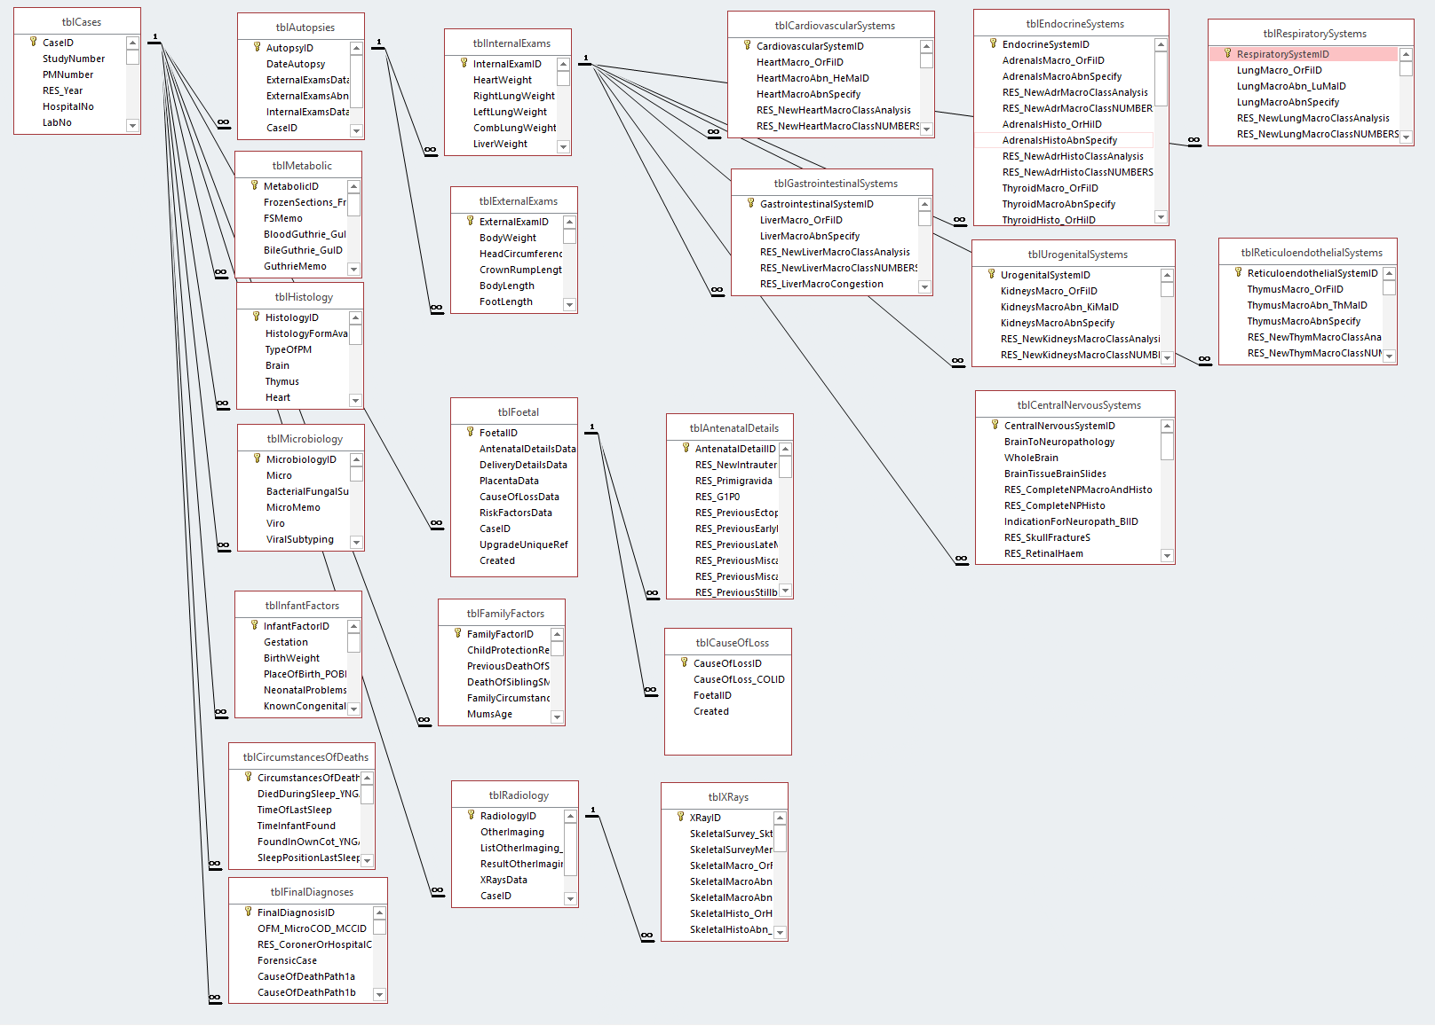
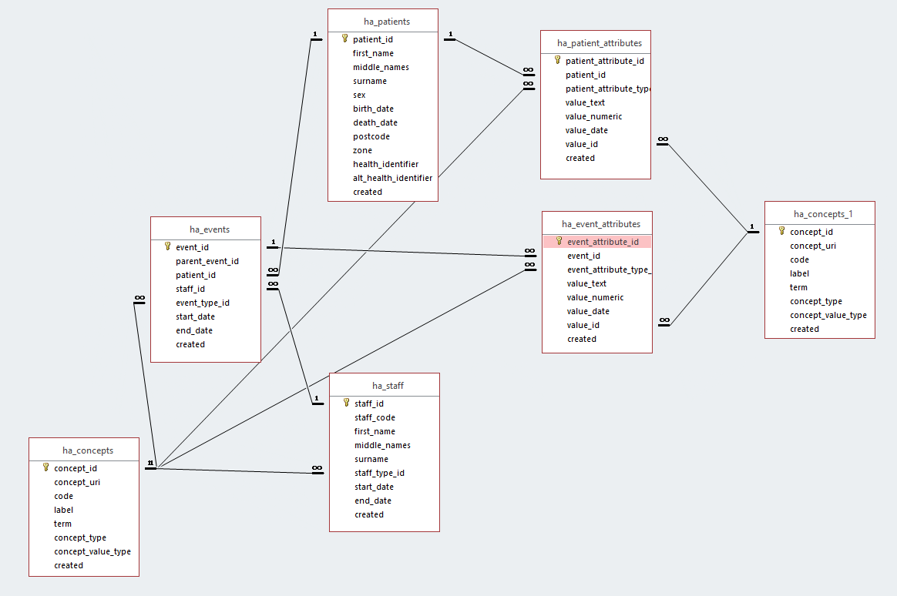
Source Data and EAV Shema
Original Post Mortem Research Database schema
Health Analytics – Event Attribute Value Schema
Please note that the source schema does not include the 134 subsidiary look up tables where as the HAS schema is complete and the ha_concepts table is shown twice for clarity.

Slide 5
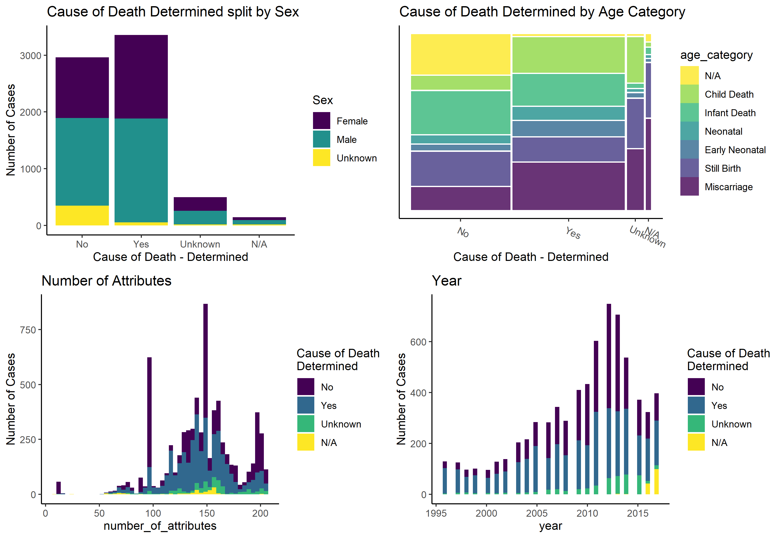
Data – Complete Data Set Visualisations

Slide 6
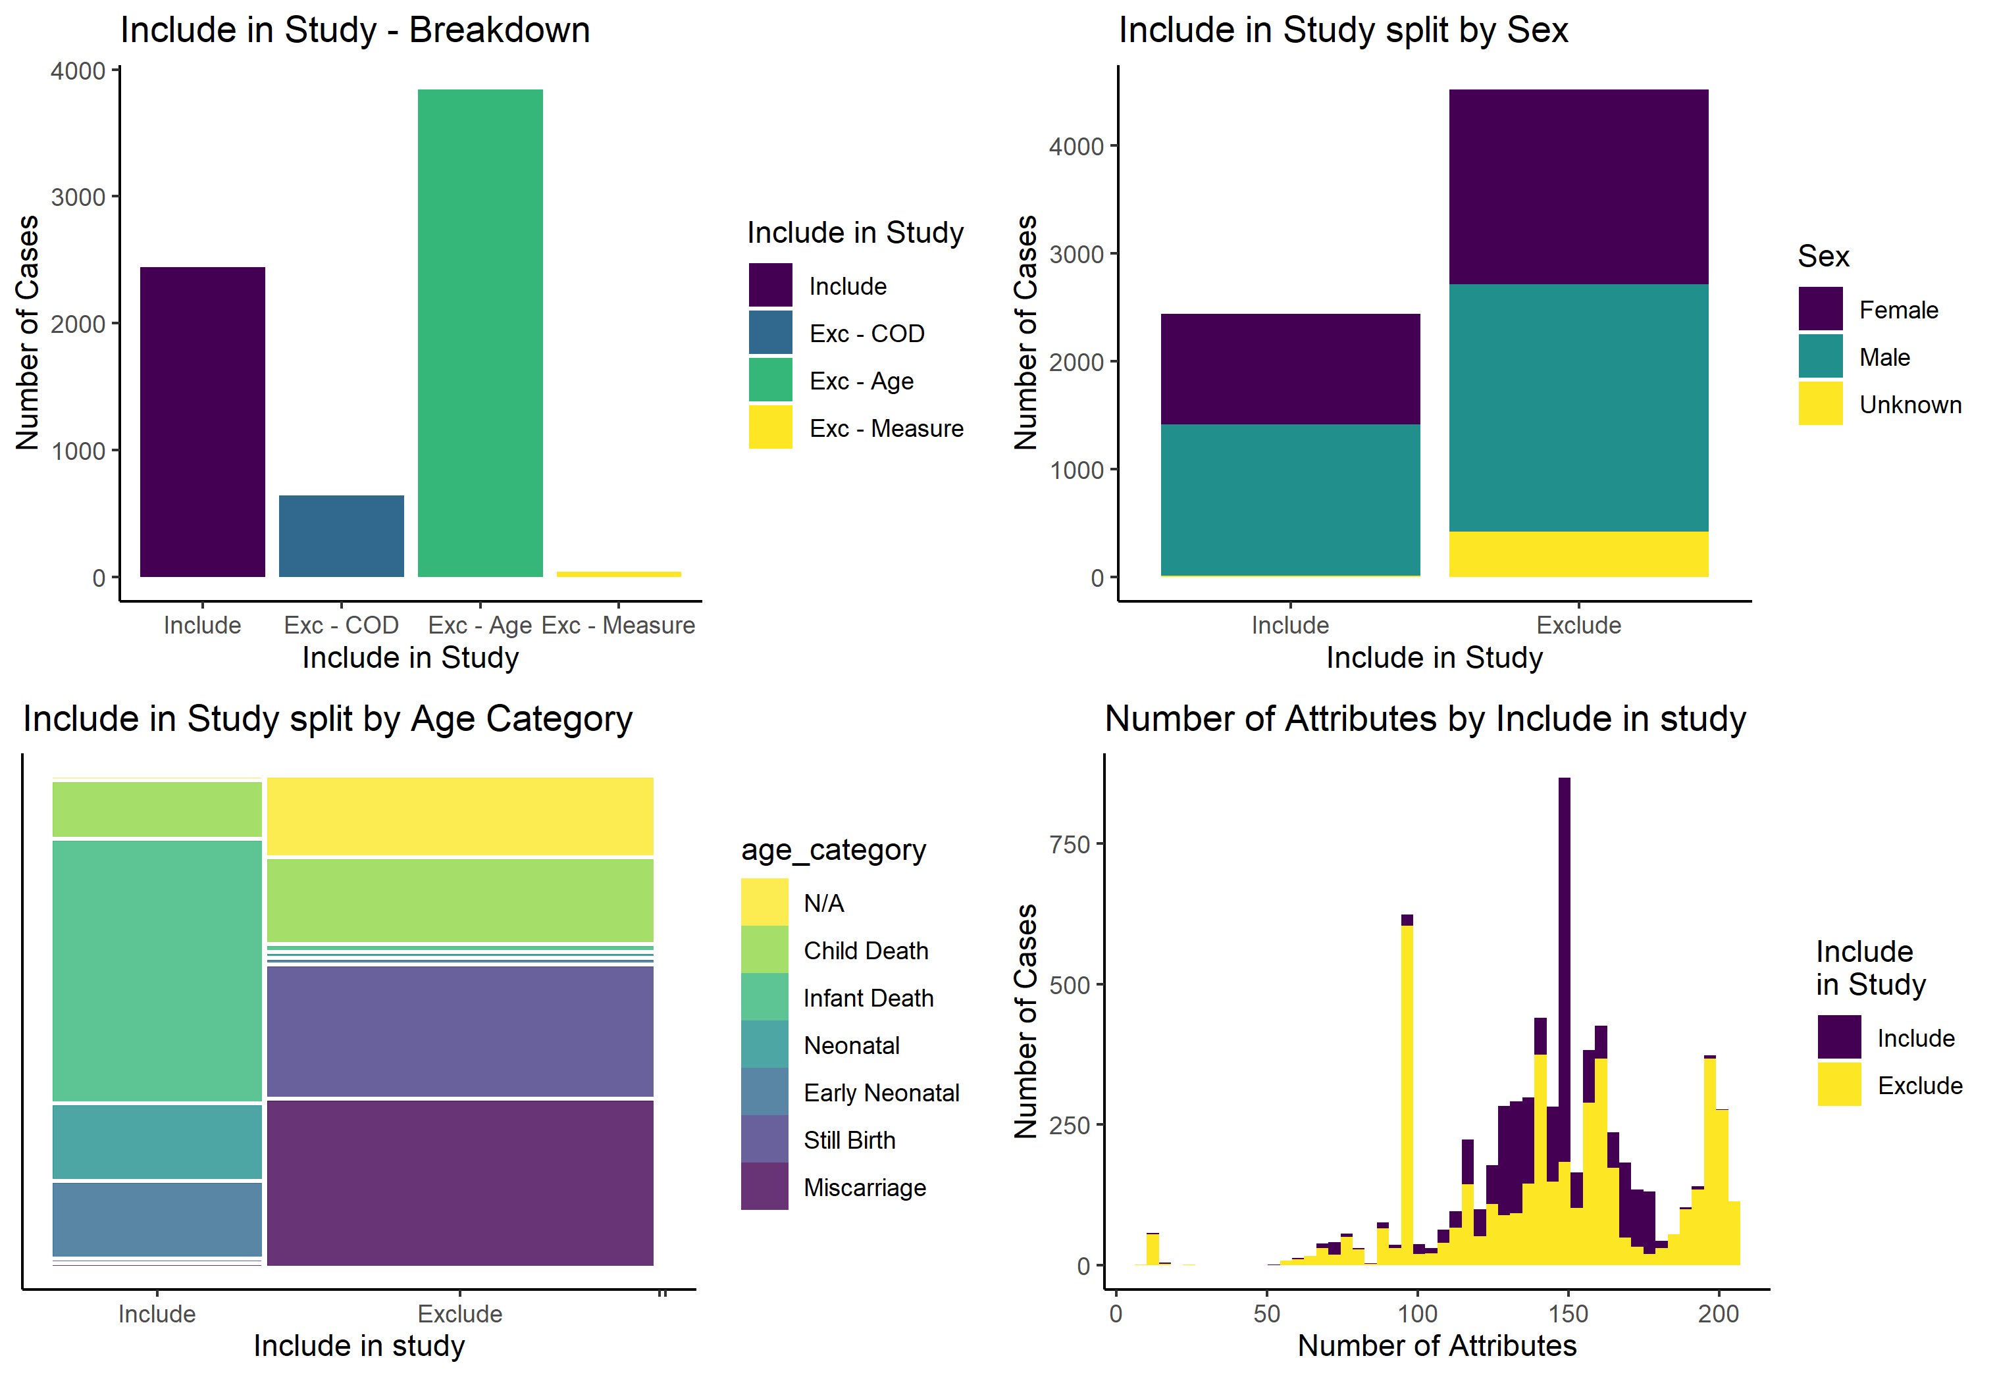
Data – Selected data for Study

Slide 7
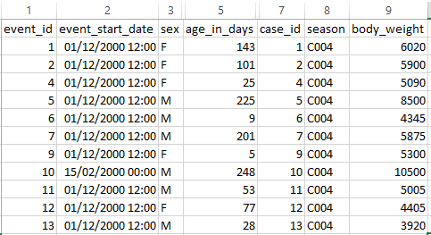
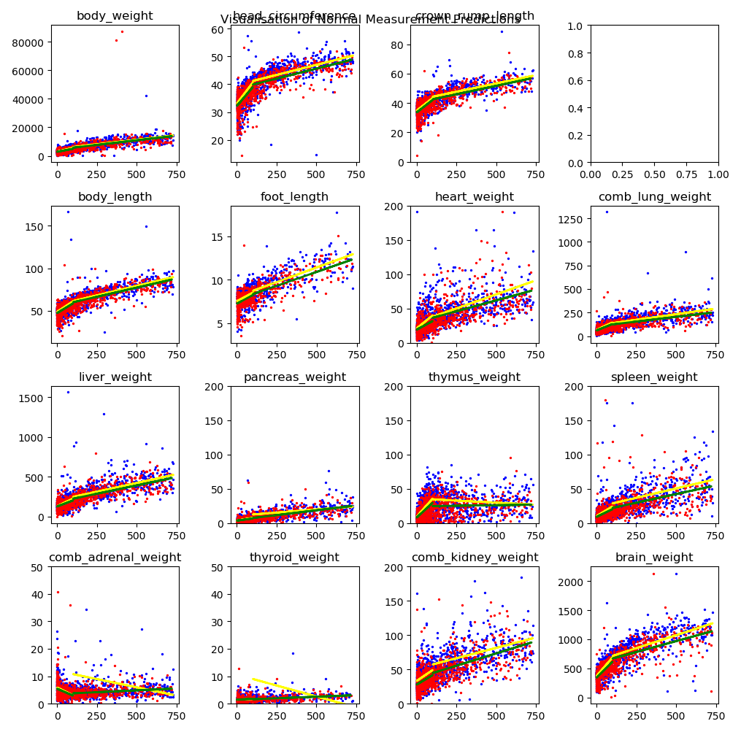
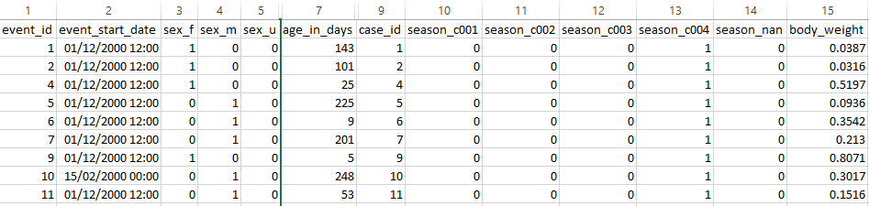
Data Wrangling
Original research data set
Linear regression on numeric variables split by age and sex
Adjusted research data set with one-hot encoding applied to categorical variables and normalisation to numeric variables.

Slide 8
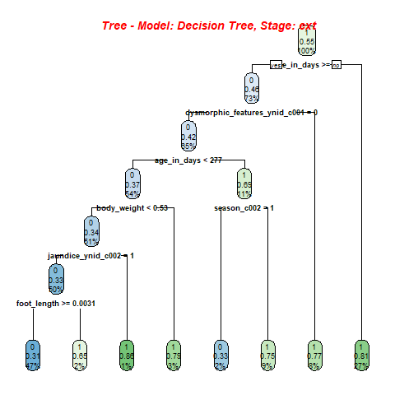
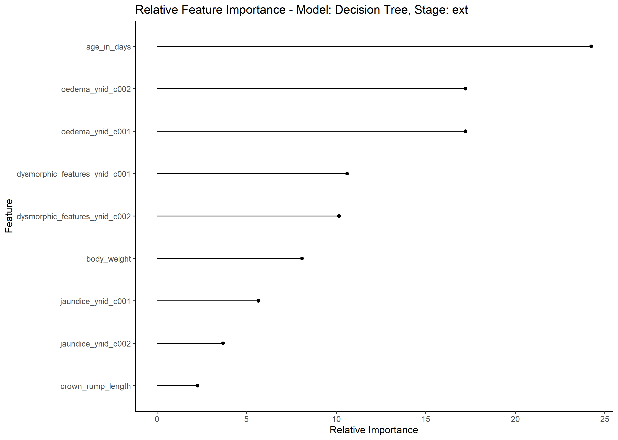
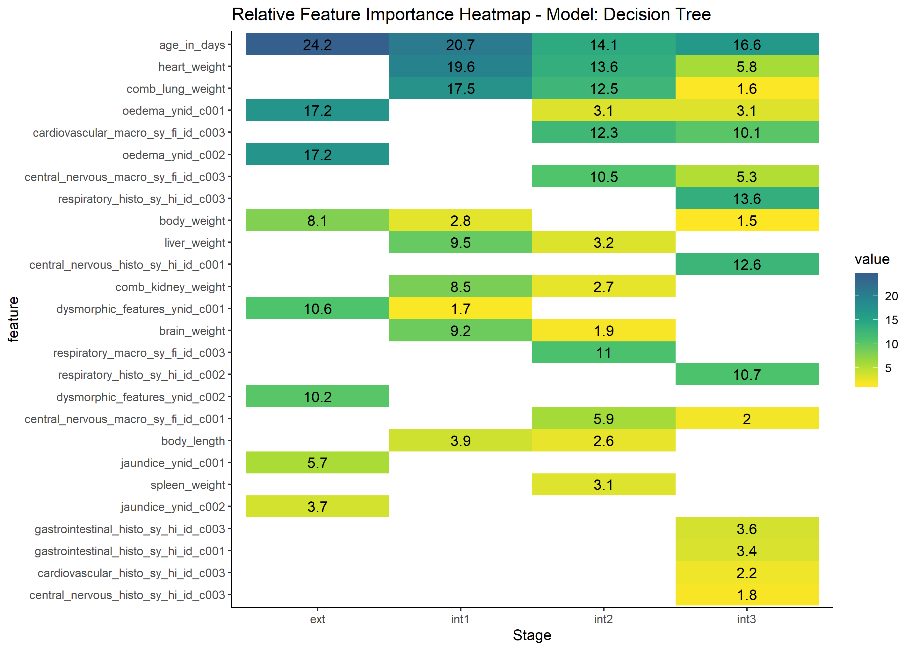
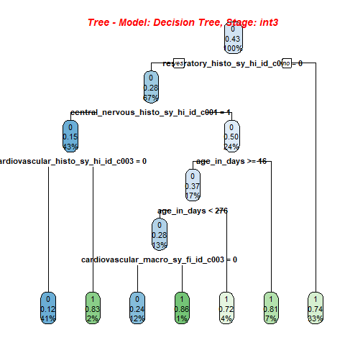
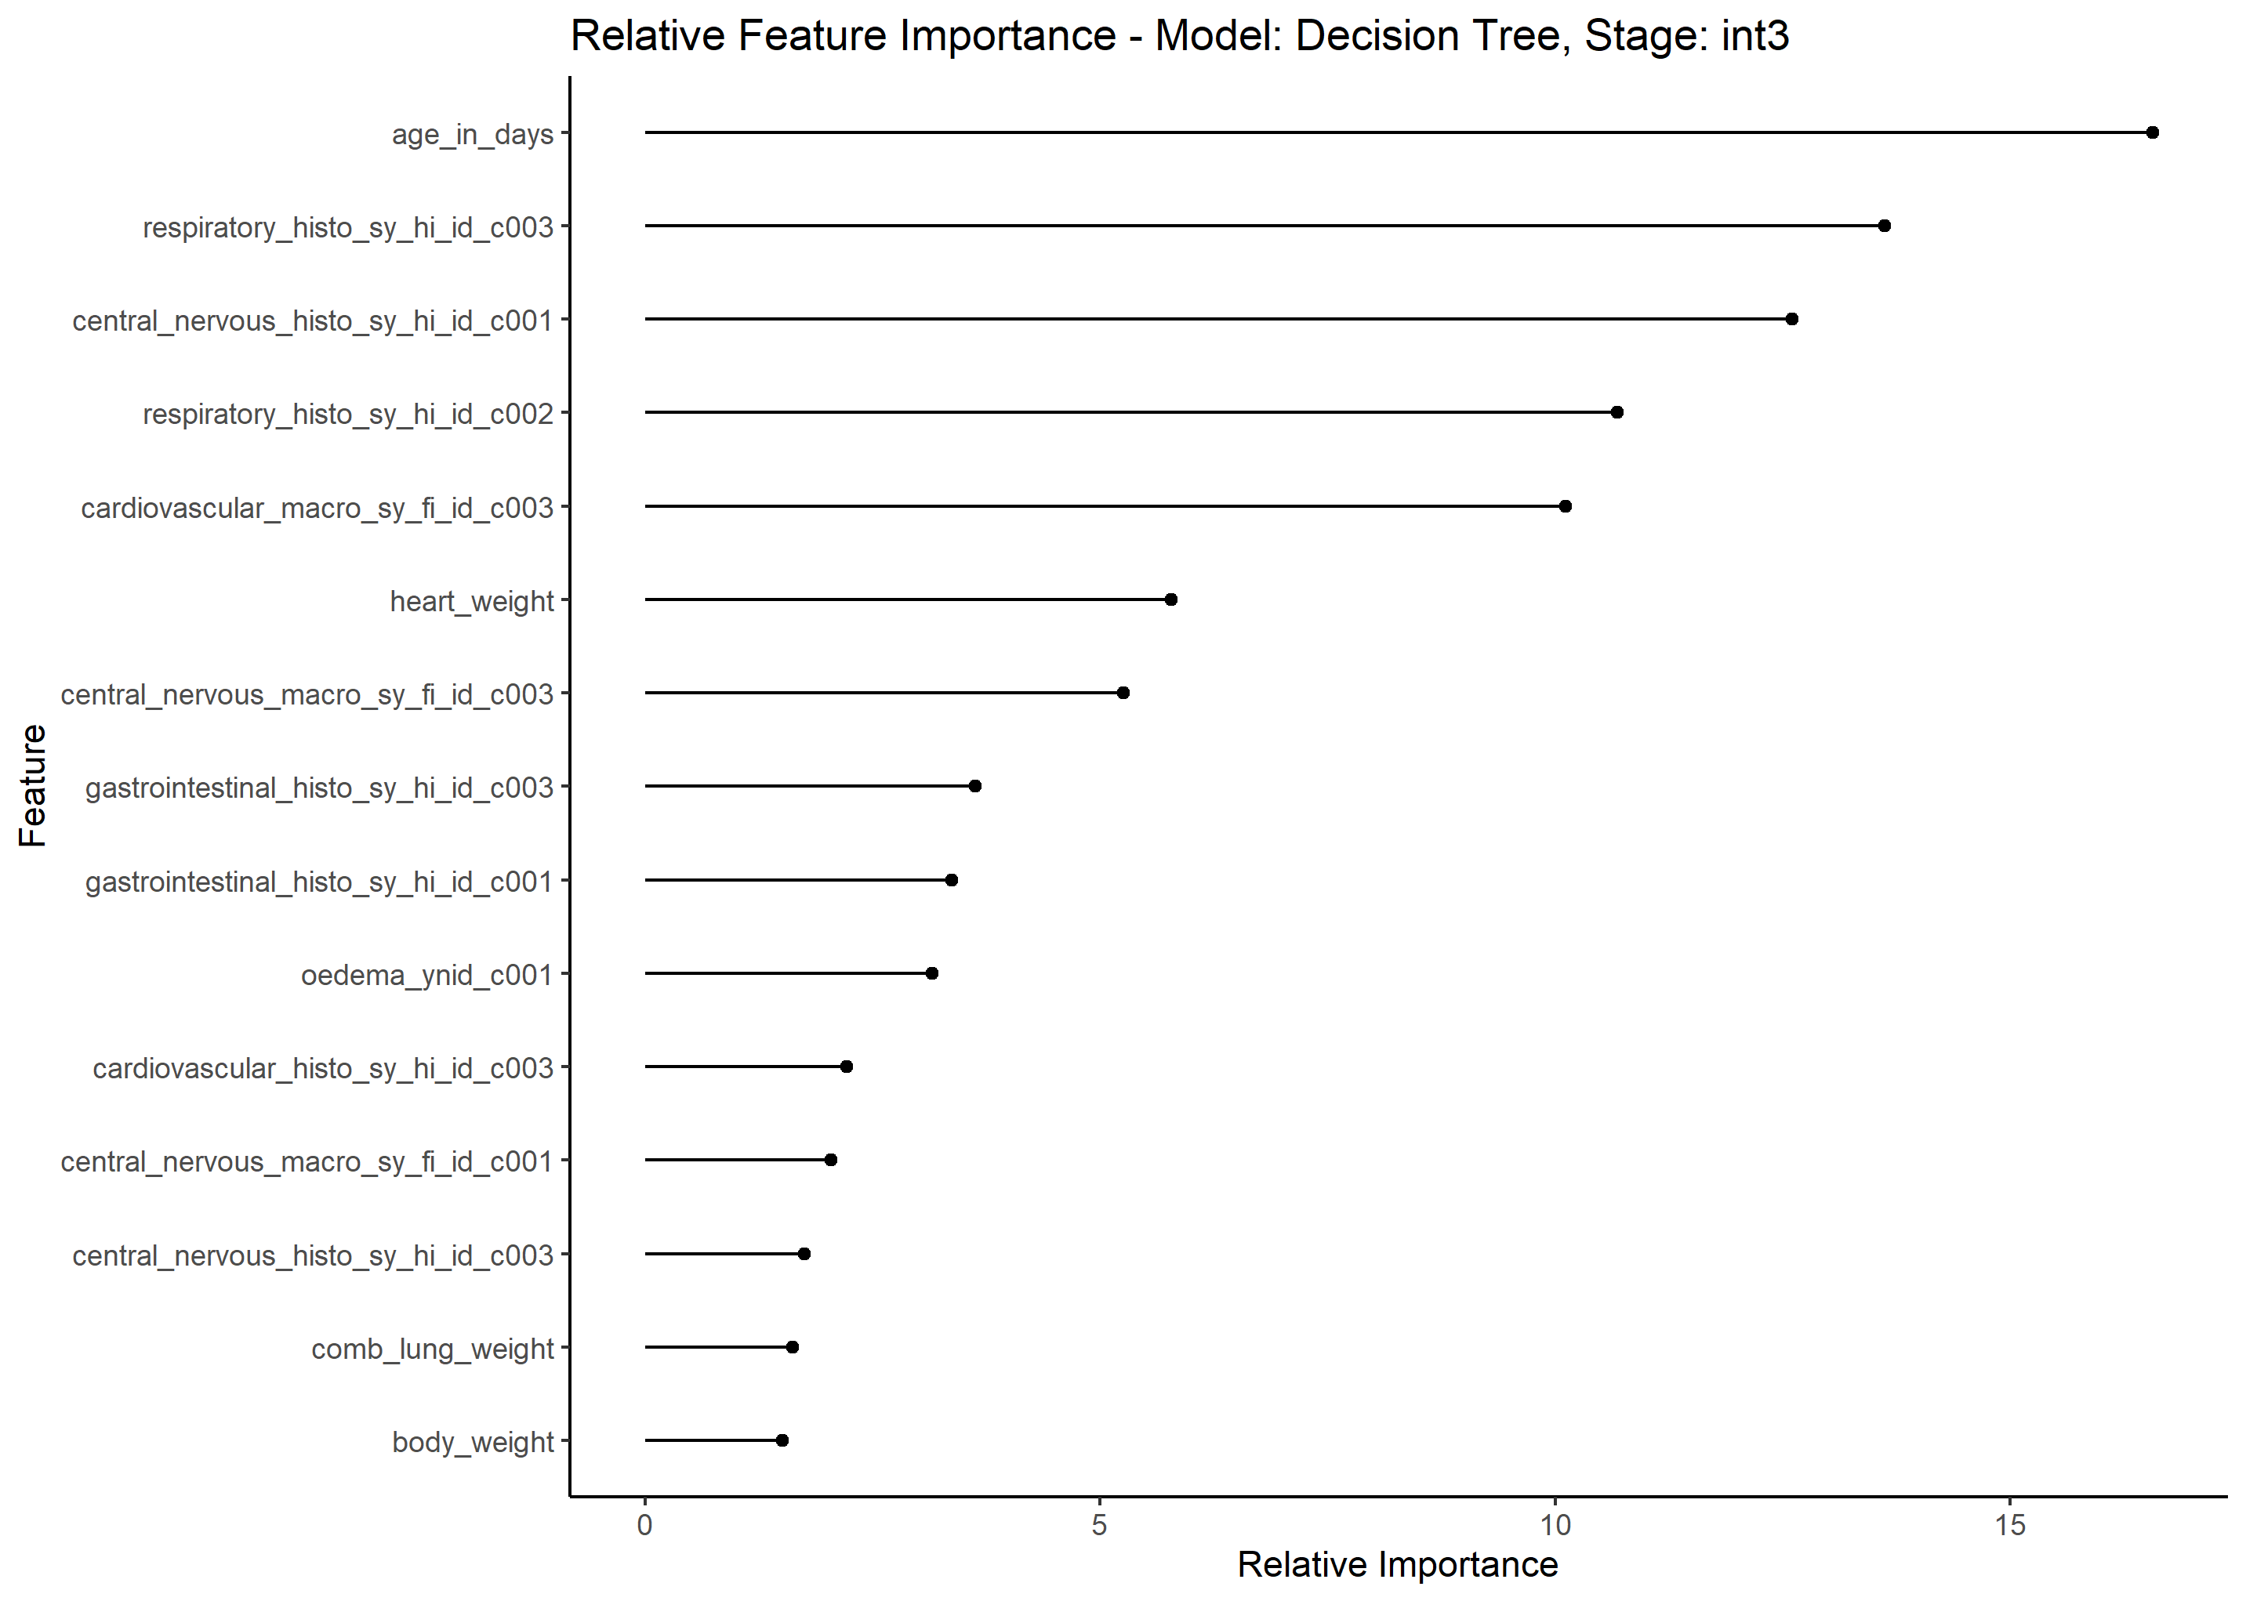
Analysis – Decision Tree Model

Slide 9
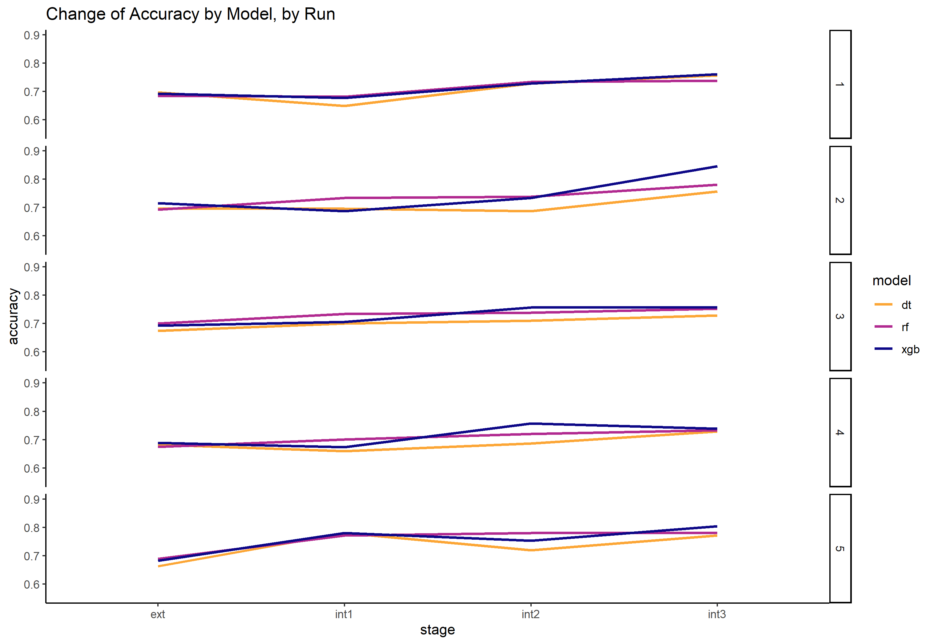
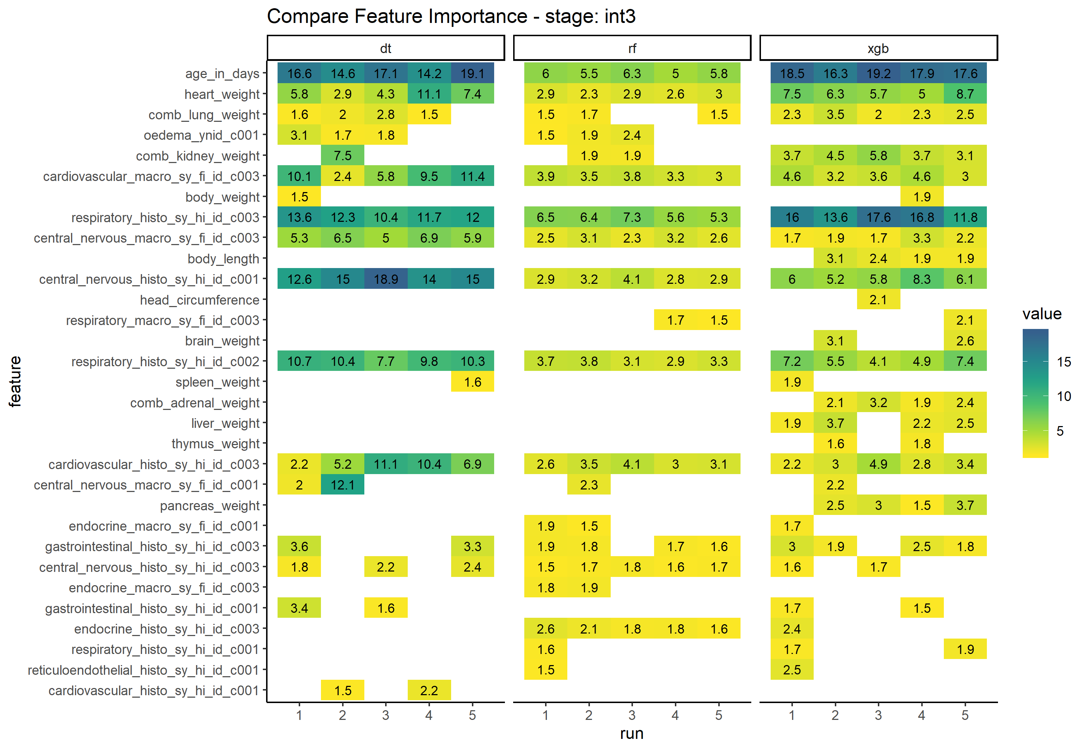
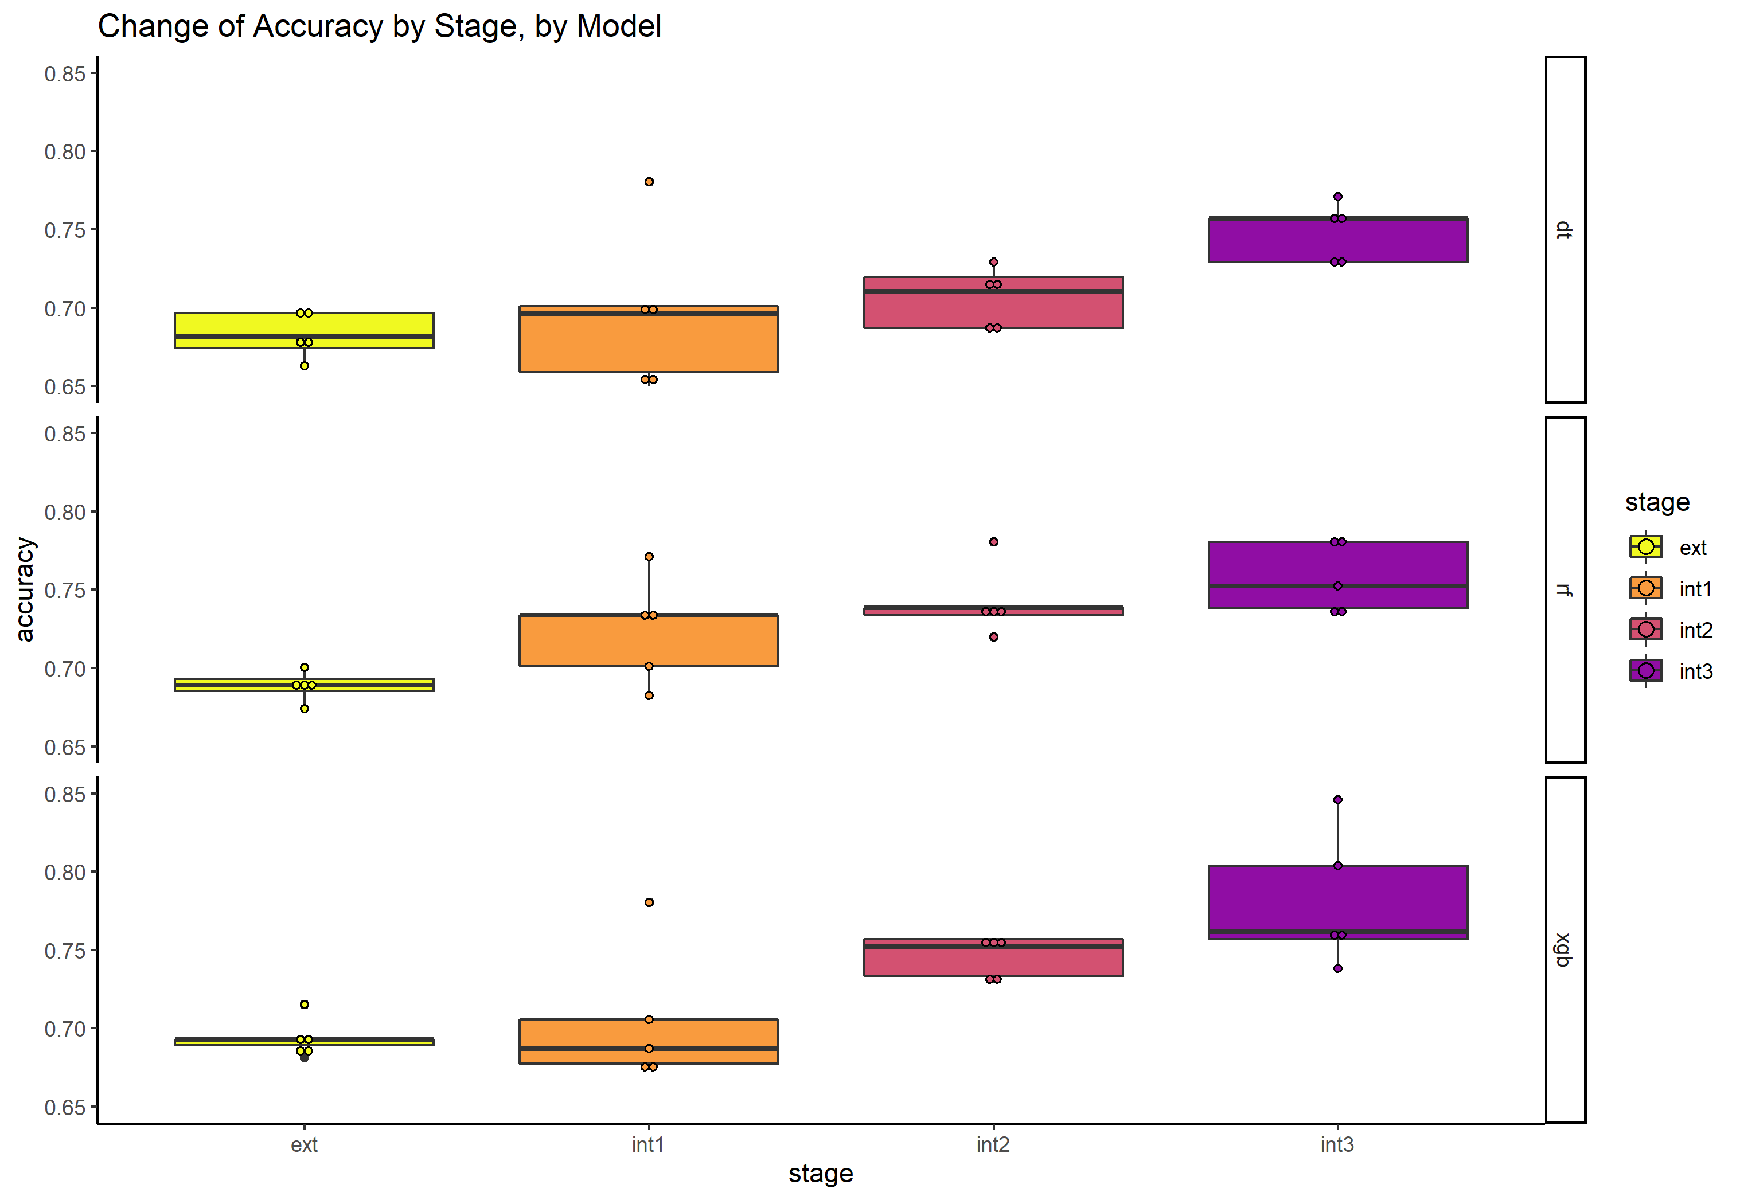
Analysis – Comparing models with different random seeds

Slide 10
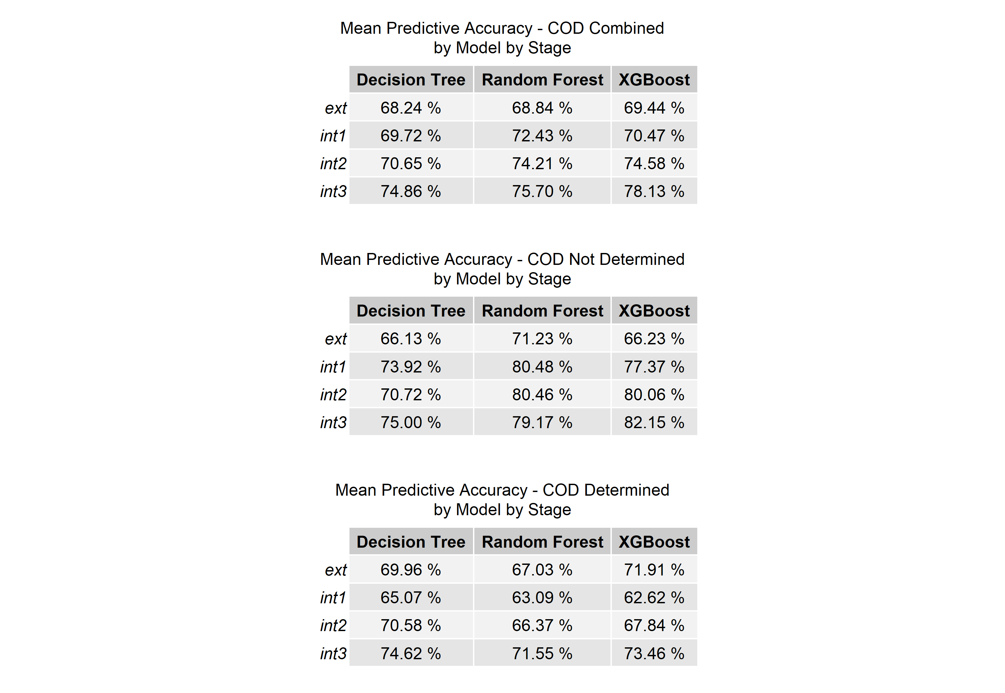
Results – 1
These percentages are the predictive accuracy of the three models with the data accumulated at the different stages of a post mortem. The numbers are derived from the mean of 5 runs using different random seeds for each run.

Slide 11
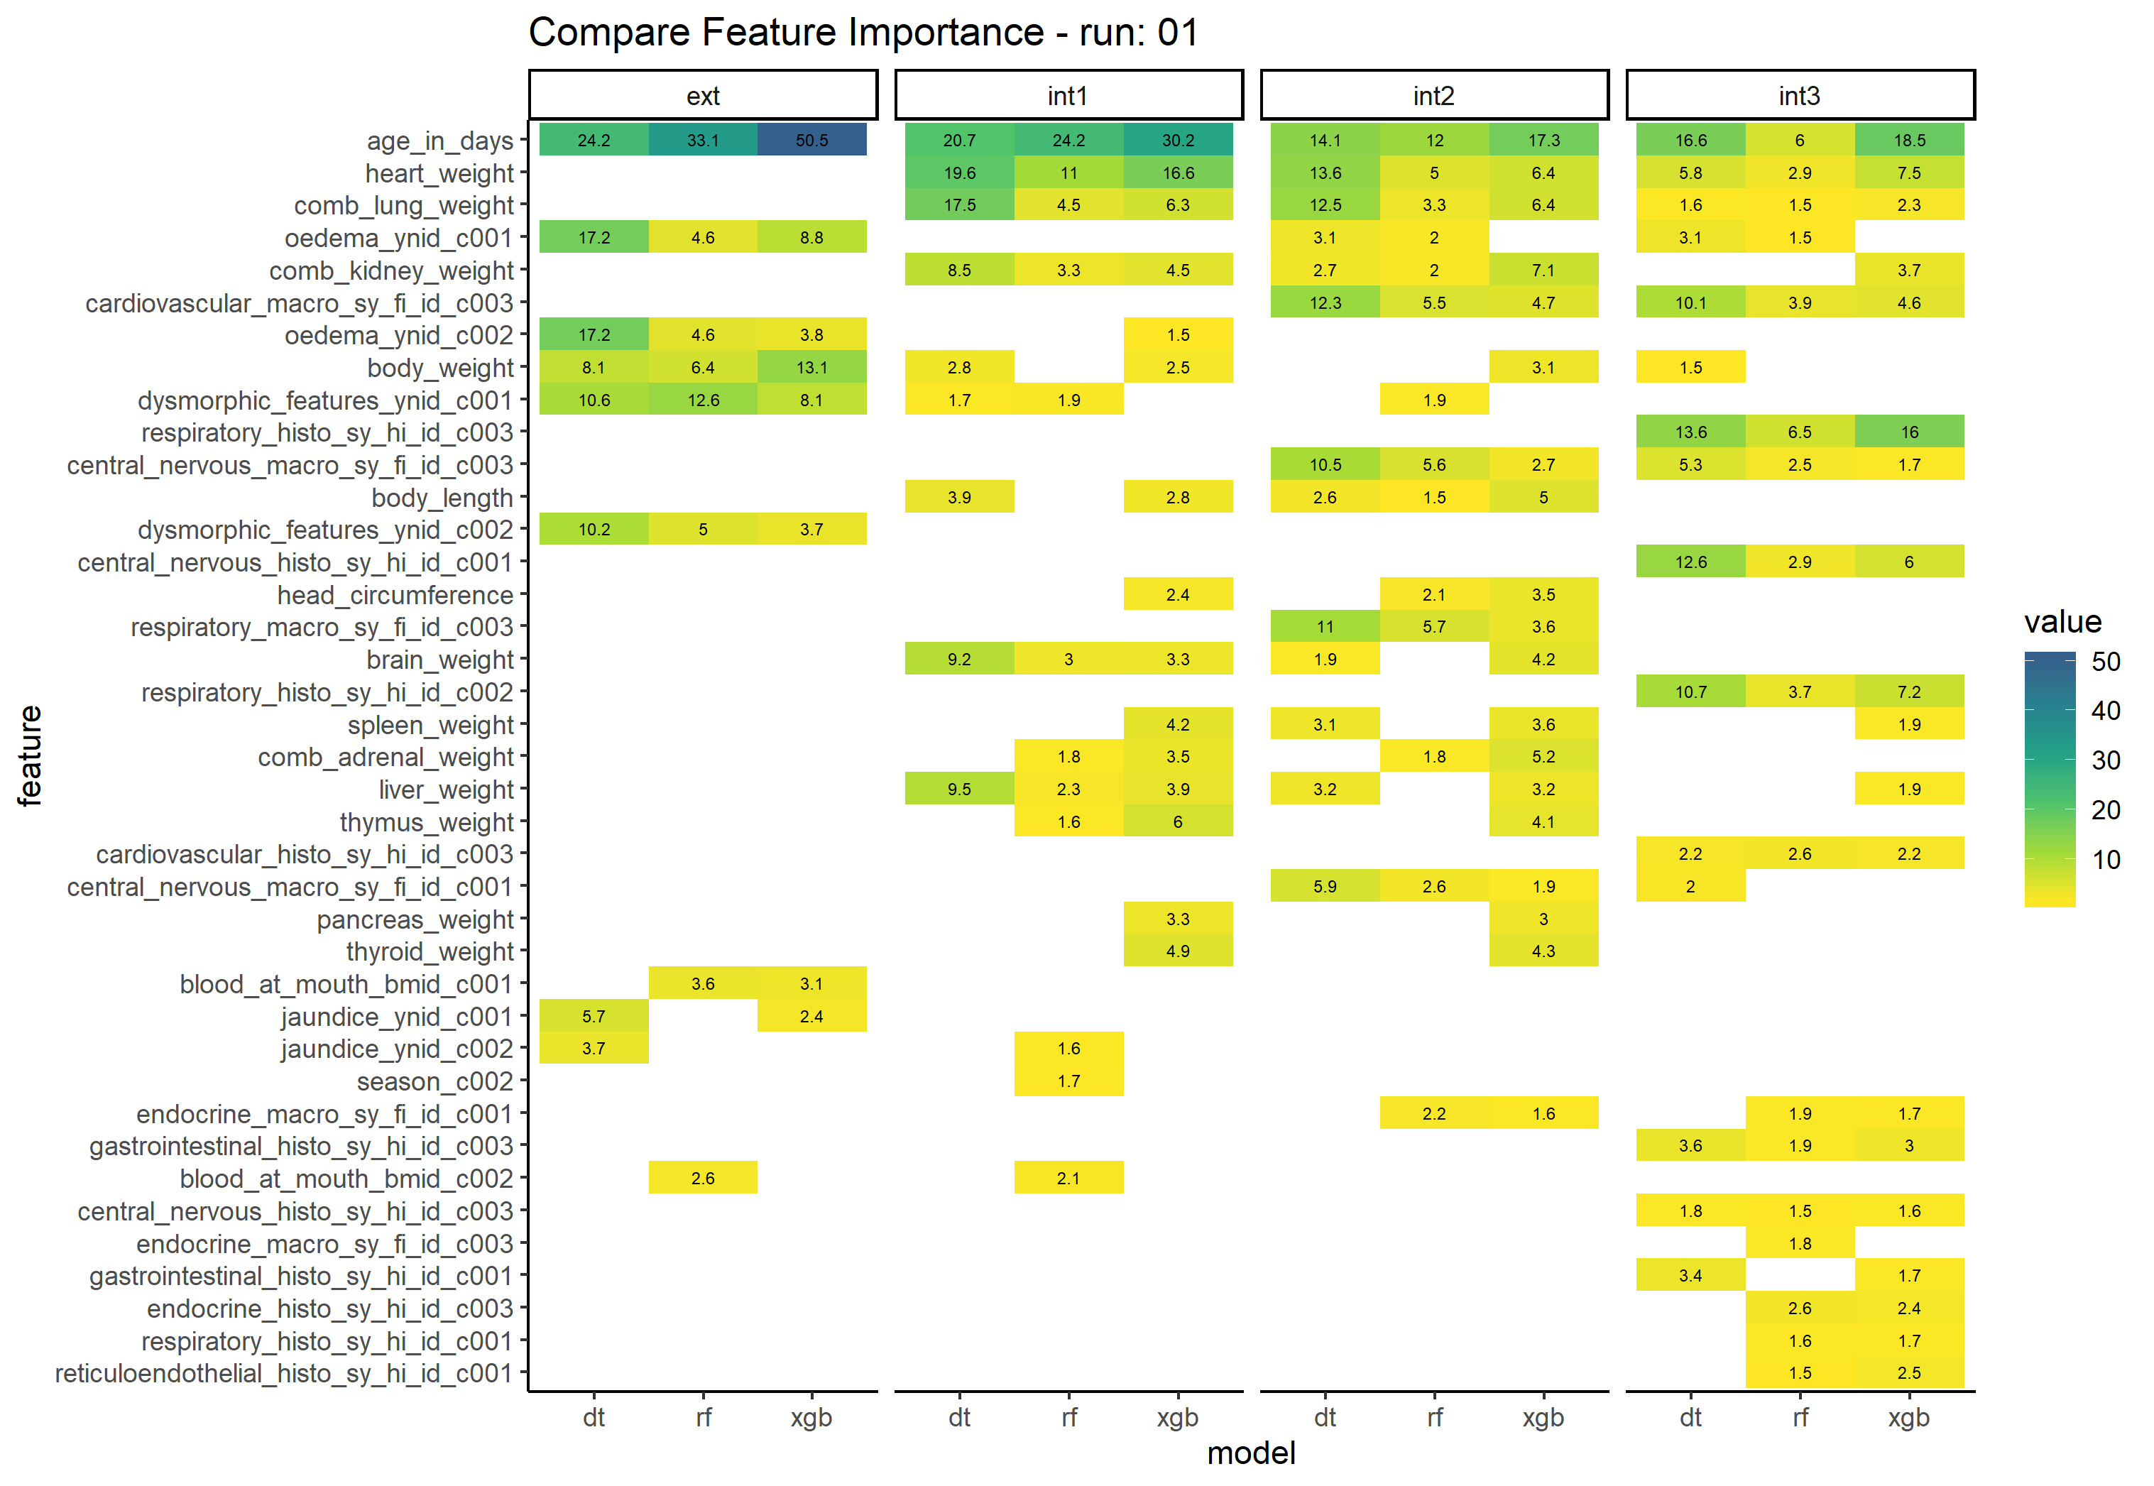
Results - 2
The heat map shows the change in feature importance as additional features are added at each stage of the post mortem as determined by the three models.

Slide 12
Conclusions and Future Work
This project clearly shows the value of collecting clinical procedural data which can then be modelled using machine learning techniques to inform clinical practice.
Areas of future work
Improved normalisation of numeric variables
Dealing with missing values NB gestational age at birth had to be dropped due to the number of missing values.

Slide 13
POWERED BY ANALYTIXAGILITY

